Slide 1
What’s New with Brackets, the Code Editor for Web Design
Jason San Jose | Sr. Computer Scientist

Slide 2
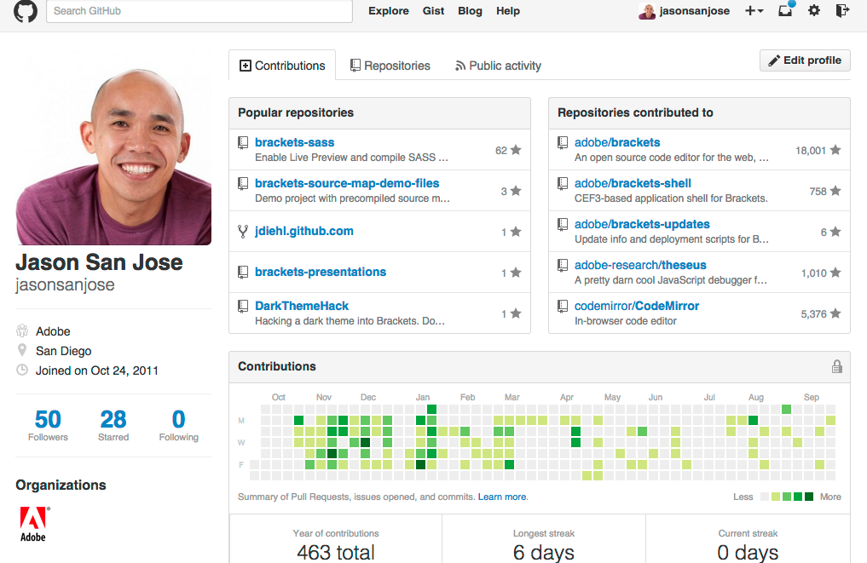
About Me
6 years at Adobe
2+ years on Brackets
“PSD Lens”
brackets-sass
3+ years on Flex/Flash Builder and Flex SDK
Twitter @jasonsanjose
Github @jasonsanjose

Slide 3
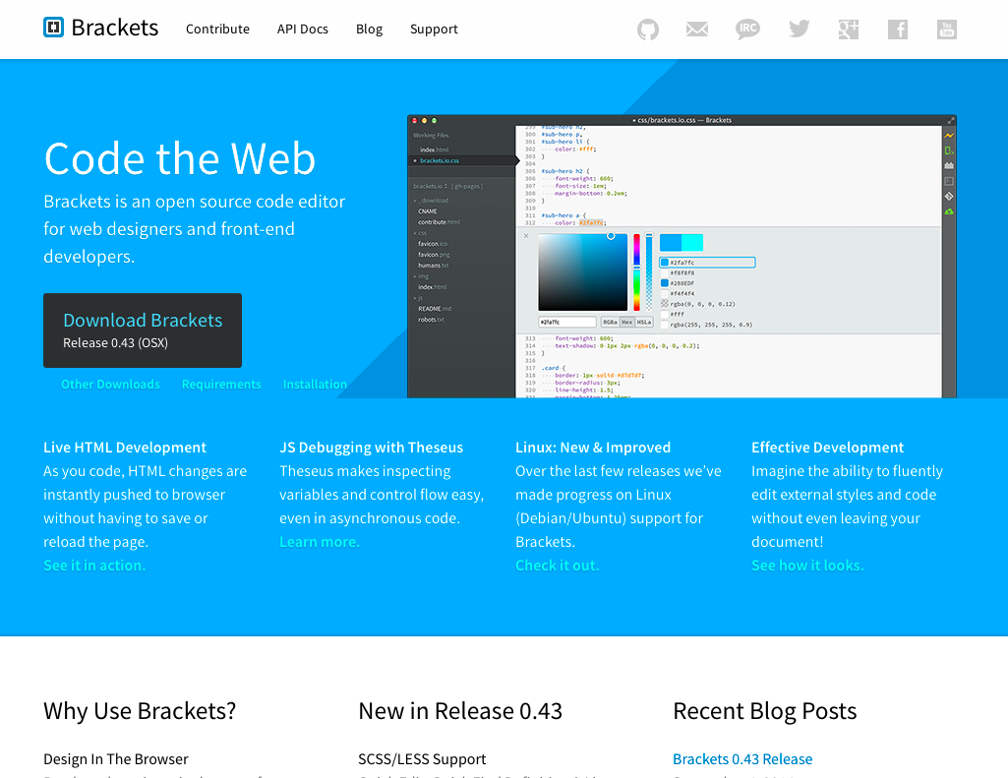
About Brackets
Price: FREE!
Open Source, MIT License
Mac, Windows and Linux
Download http://brackets.io
Github http://github.com/adobe/brackets
Twitter @brackets
New updates every 2-3 weeks

Slide 4

What to Expect
You: Probably not an active Brackets user
New to Brackets or maybe tried an older version
Highlight new Brackets features and extensions from the last year
Lots of demos and not a ton slides
Not a “developer” talk
Preview of “PSD Lens”
Q/A
Want more Brackets?
Today, October 7, 4pm – Room 512 Creative Coding: Front End Design & Development with Brackets Peter Flynn, Sr. Computer Scientist, Brackets
Tomorrow, October 8, 11am – Room 411 Going from Design to Code Ryan Stewart, Sr. Product Manager, Brackets

Slide 5
The Basics
Themes
New Untitled Files / Save as…
Drag and Drop file/folder from OS
Find/Replace
New UI
Replace All
Tickmarks
Regular Expression Substitution
Exclude Files from Find in Files
Extension Manager

Slide 6
Developer Features
Multiple Cursors
Split View
JavaScript Code Hints
Switch Language

Slide 7
Designer Features
HTML Support in Live Preview
SCSS and LESS Support in Code Hints and Quick Edit
Create New CSS Rule from Quick Edit
“PSD Lens”

Slide 8
Extensions
Extensions Rating
Brackets SASS
Brackets GIT

Slide 9
Roadmap and Contributing
Home Page http://brackets.io
Github http://github.com/adobe/brackets
Trello Backlog https://trello.com/board/brackets/4f90a6d98f77505d7940ce88
Waffle https://waffle.io/adobe/brackets

Slide 10
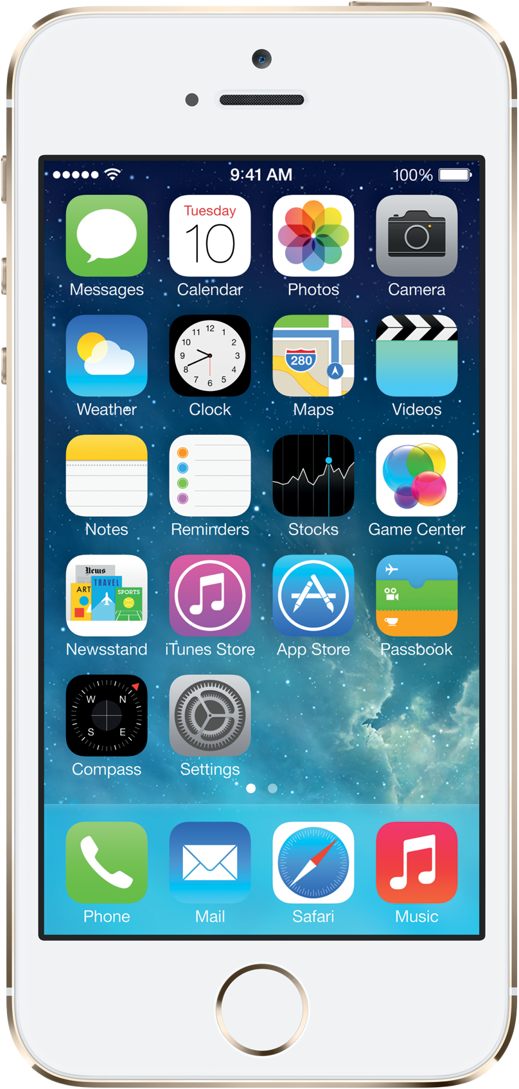
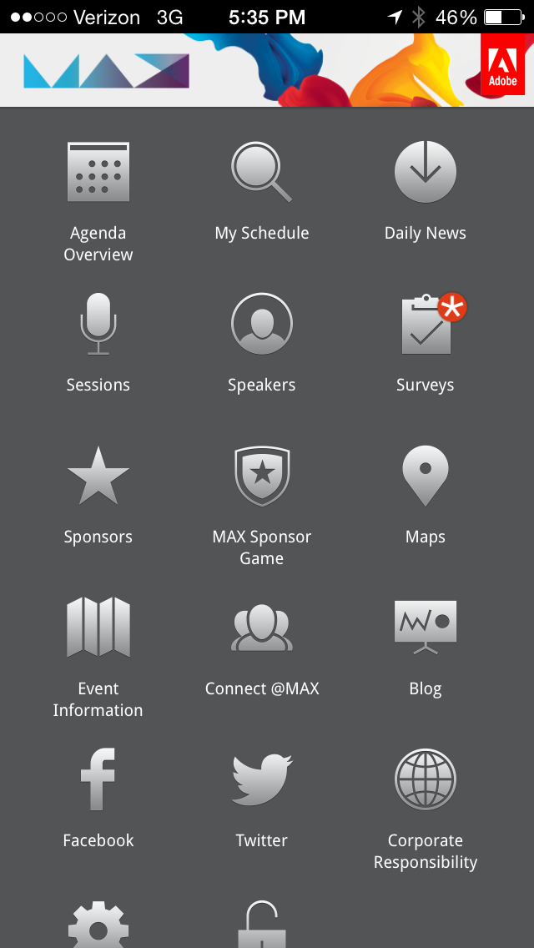


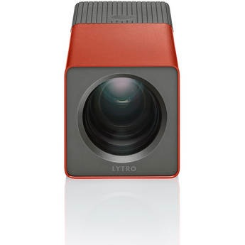


Take the SESSION SURVEY on the MAX mobile app
…for your chance to WIN one of these e-books from Adobe Press
Every survey you submit enters your name to win the daily grand prize:
Lytro 16GB Light Field Digital Camera.

Slide 11


Slide 12
Outline Notes
Must Cover
Live Preview CSS, HTML (only HTML is new…maybe SASS?)
Themes
E4B
Multiple Cursors 0.38
Split View 0.44
Extensions
Roadmap and Contributing
New since MAX 2013, >=sprint 25
Extension Manager
JavaScript code hints
Save as, untitled
Drag and drop from OS
Find/Replace UI, replace all, tickmarks, regexp sub, exclude files
SCSS, LESS support (hints and quick edit)
Quick edit, create new rule
Switch language in status bar 0.42
Extensions
brackets-sass
brackets-git

